Slide 1


NTTN Governance Meeting
Wk-10

Slide 2
Agenda
Last two weeks RCA closing with fault and quality with interim and permanent remedy
Repetitive outage remedy timeline follow up
CTG North and Mymensingh zonal improvement plan for outage frequency high
QoS and loss reporting modality and automation
SOC monitoring with topology in full fledge
Preventive maintenance report and summer preparation
Check list(Actions) chronology for frame loss/fault fix.

Slide 3
Network Availability (6 Months)

Slide 4
Gazipur & Mymensingh zonal improvement plan
SL NO | Link Names | Up-gradation | Dead-line | Remarks
1 | Mymensingh-Gazipur backbone | 10 G to 20 G | 15 Mar 2019
2 | Uttara-Pubail & Pubail to Gazipur | 10G to 100G | 14 Mar 2019 | Done
3 | Pubail-DH03-Gazipur links | 20G to 30G | 22 Mar 2019
4 | New link establishment at Tangail | 10 G | 20 Mar 2019
5 | 3 links up-gradation at Jamalpur | 1G to 10G | 13 Mar 2019 | Dependency: ROBI could not arrange access at JPSDR02 site
6 | MYSDR03 - MYPGCB link up-gradation | 1G to 2G | 14 Mar 2019
7 | Gazipur POP - DH03 new fiber route |  | 30 Mar 2019
8 | Tongi Station Road- Uttara House Building new fiber route |  | 10 Apr 2019

Slide 5
Ongoing Network Improvement Activity/ Summer Preparation by SCL
Preventive Maintenance
Network Swap 1st Phase
Network Swap 2nd Phase
Preventive Maintenance (phase-1)
E2E network swap
Total: 185 site Done: 185 site Remaining: 0 site
Increases 332 access link’s capacity from 1G to 10G
Network swap with higher capacity device
Increases link’s capacity from 1G to 10G
Total: 684 link
Done: 301
Pending: 383
Deadline: 30-Apr-19
Total : 390 Link Done: 362 Link Remaining: 28 link Deadline: March’19 | Total : 266 sites Done: 243 sites Remaining: 23 sites Deadline: March’19
Ring Modification and up-gradation
Link Shifting from OH fiber to UG fiber
Link Shifting from OH fiber to UG fiber
Analyzing the traffic flow and link utilization, ring modification & capacity upgradation.
Total : 66 Done: 35 Remaining: 31
Link shifting from OH fiber to newly deployed UG fiber.
Total Target: ~1000Km fiber
Done: 0 km
Deadline: 31-May-19
Regular checkup & Fiber Loss Rectification
Rectification SLA 24-48 hrs

Slide 6
Check list(Actions) for Quality Issues
Step-1: | Find out the available paths from access site to HO site.
Step-2: | Check capacity congestion in the available paths.
Step-3: | If any congestion found, then check other available paths to re-route traffic.
Step-4: | For no issue found at Step-2 &3, check high RSL of the available paths.
Step-5: | For any high RSL found, check if other available paths are okay, then re-route traffic to that path.
Step-6: | With above step, deactivate the infected link and inform RIO to rectify.
Step-7: | After logical rectification, check ping and traceroute status from access site to HO site.

Slide 7
Major Incident RCA Analysis and fixing (Wk- 9 & 10)
Severity | Summary* | Open Date | Close Date | Duration | Root Cause | Action Taken | Parmanent Solution
C-1 | 162 Sites under DBE03,DBE01,DBE44,DBE78,DBE87,DBE69,DBE38,DBE86,DBE05,DBE88,DBE42 and 14 Node B under DRE01,DRE29,DRE28,DRE14 are down since 04:13 | 3/9/19 4:13 AM | 3/9/19 9:26 AM | 5:13:00 | Dhaka-2 to HUB98: Due to drainage activity by DNCC, SCL UG fiber 432 core and Enclosure were got damaged at Malibag, Maxim HH. Dhaka-2 to HUB02: SCL UG Fiber 432 core was damaged at Paribagh due to HDD activity by Hamida Traders Ltd (Vendor BdREN) | - New GCO was installed and fiber was rectified. - Officially informed to Hamida Traders Ltd (Vendor BdREN) for permanent solution. | - Common path for both link of DH2-HUB02. We shall separate the route by 16-Mar-19. - Assigned patrolling team for monitoring purpose 24*7. - Guided team to ensure confirmation once link is rectified.
C-2 | 28 Node B under DRH05,DRH21 are down since 19:44 | 2/27/19 7:44 PM | 2/27/19 11:25 PM | 3:41:00 | KSBRB03 was down due to Robi base site power issue at KSKLC08 and other hand was down due to OFC cut for heavy hailstrom. | Restored the down link | Team has changed the damaged fiber.
C-1 | BSC DBM20 was down | 3/5/19 4:07 PM | 3/5/19 4:27 PM | 0:20:00 | Patch chord mismatch while physical integration at active link & protection link down at Rajshahi Naogoan portion within short interval | we had immediately rolled backed the active link | We had immediately rolled backed the active link. We taking are care & observing this high important link
C-2 | 29 Node B under DRE35 & 11 eNode B are are down since 15:48 | 3/3/19 3:48 PM | 3/3/19 4:55 PM | 1:07:00 | LDP protocol was missing. | Configured LDP protocol | Guided to to check all protocol related configuration & status during implementing any link.

Slide 8
Dark Core Links Availability Summary
Month-Wise Link Down:
Dec: 16
Jan: 23
Total Unique Link: 33
Feb: 16
SLA Achieved
SLA Failed

Slide 9
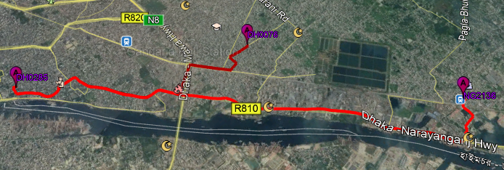
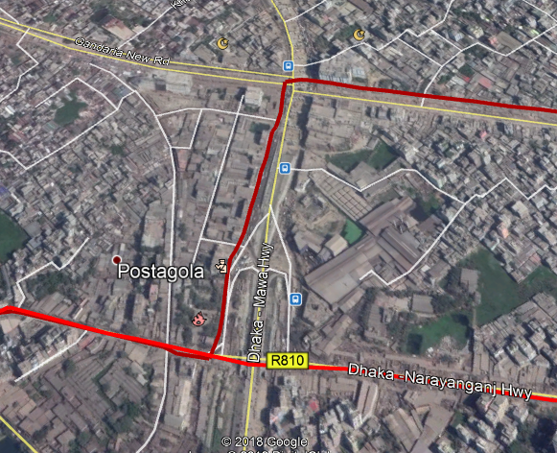
SLA Failed/ Repetitive Dark Core Links
Link Name | Link Availability (01-Dec-18 to 17-Feb-19) | Action Plan/Alternative Solution
DHKDM30(DH0076) to DHSTR68(DH0285) SCL DWDM | 98.5% | Solved. Approx 1100m link shifting OH to UG shifting done and approx 1800m old cable to new cable rerouting done at Postogola, Sutrapur area.
DHPTN42(Dhaka_2) to DHRMN03(Moghbazar) SCL OSN | 98.9% | Solved
DHPTN42(Dhaka_2) to DHSBG62(HUB_2) SCL DWDM | 98.1% | Common path for both link of DH2-HUB02. We shall separate the route by 21-Mar-19.
NGSDRG3(NG2136) to DHSTR68(DH0285) SCL DWDM | 98.9% | Solved. Approx 1800m rerouting from Old cable to new cable done at Narinda Area.
Affected Area due RHD activity

Slide 10
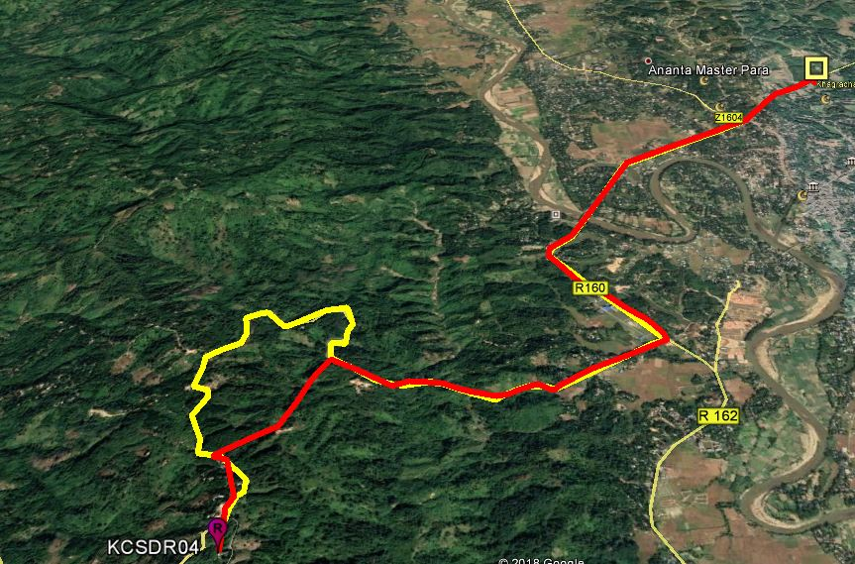
Improvements regarding PM activities in Hill Tracks
Total Coverage Area : 300 km (Approx.) Rangamati & Khagrachori Zone.
Completed coverage area :186 KM approx.
Total TJB Fixed :45 Nos.
Total Clamping Done : 59 Nos.
Total New Cable Pulled : 1437 Meter
Total Bend Rectification :32 Nos.
Road Cross Height Increase :6 Nos.
Pending PM coverage area : For 110 km (Alutila to Fatikchori Bibirhat ). We need to reroute the 4km cable from Alutila to Bibirhat portion.
Current Route : Red Marked
Planned New Route : Yellow Marked

Slide 11
Quality Issue
incident_title | Update
Huge frame loss in GPSRP77 | Cable changed at last mile.
| huge frame loss from TNMZP02 POP | Capacity issue solved
high frame loss under FNSDR35pop | No problem, found
high ping loss in BH under Pop SYBSW01. | High loss issue solved
|HS frame loss in LXSDR38 nodeB under Pop: LXSDR12 | No problem, found
Ping loss in MYSDR02 nodeB | No problem, found
high Ping Loss in 159 Node-B Under (RNC: DRH19) since 6-Mar 3PM | Mulitple BB break
|high frame loss in GPSDR1N nodeB POP: GPSDR11 Vlan: 1012, 2012 | No problem, found
Robi is getting Frame loss under GPKLK59 pop | Capacity issue solved
HS Frame Loss in 75 Node-B Under DRE37 on 4-March 8 PM to 11 PM | High loss issue solved
Robi getting high frame loss in 35 NodeB under DRE12 | | Logical problem solved
ROBi is getting TNBSL01 & TNSKP06 POP frame loss | Capacity issue. Solution ongoing
ROBI is observing high DCH Frame Loss in 61 Node-B Under CRE25 since 5-March | Capacity issue temorary solved. Permanent ongoing
ROBi is observing high DCH Frame Loss in 69 Node-B Under CRE32 on 11 PM since 5-Mar | Capacity issue temorary solved. Permanent ongoing
ROBi is observing high DCH Frame Loss in 45 Node-B Under CRE06 since 4-March | Capacity issue temorary solved. Permanent ongoing
|Robi getting Frame Loss in 69 Node B Under CRE32 | Capacity issue temorary solved. Permanent ongoing

Slide 12
Thank
You

